Slide 1








Avatars scenario library Healthcare
DECEMBER 2021

Slide 2














Medical furniture

Slide 3











Medical furniture

Slide 4





Example background scene

Slide 5




Example background scene

Slide 6



Example background scene

Slide 7
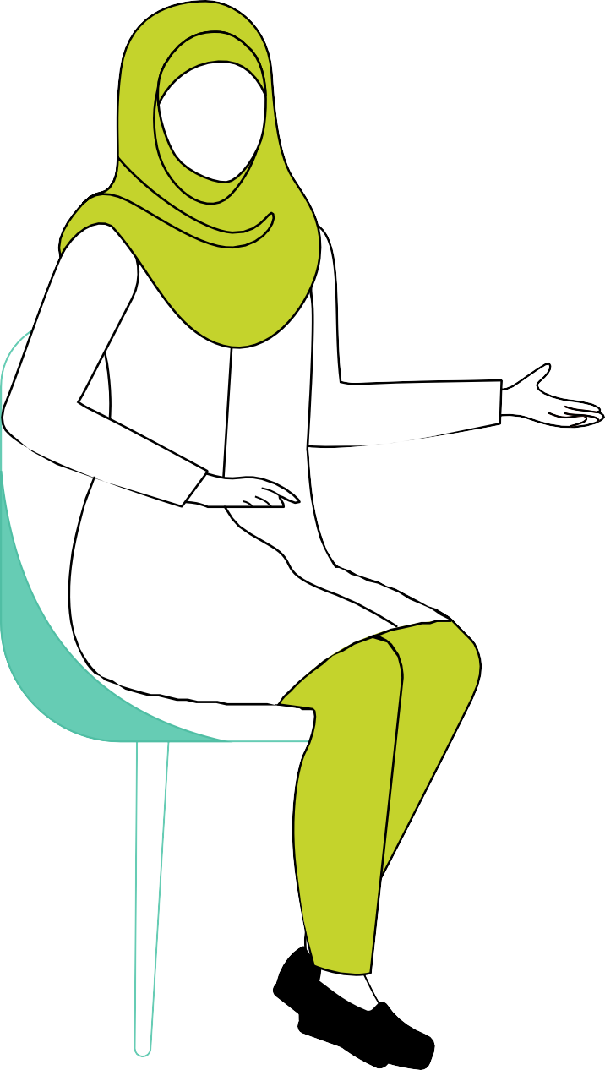
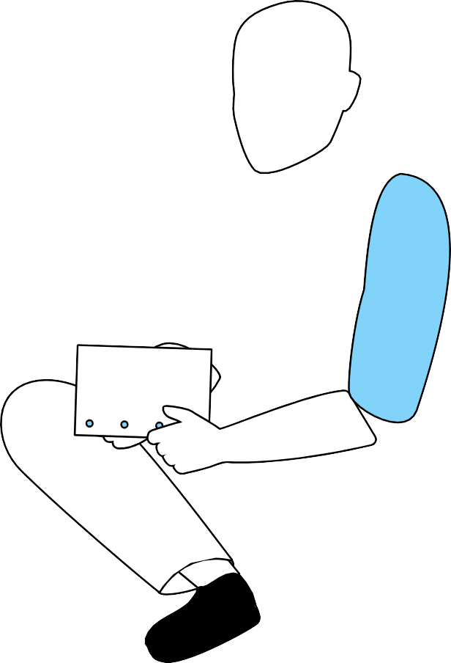
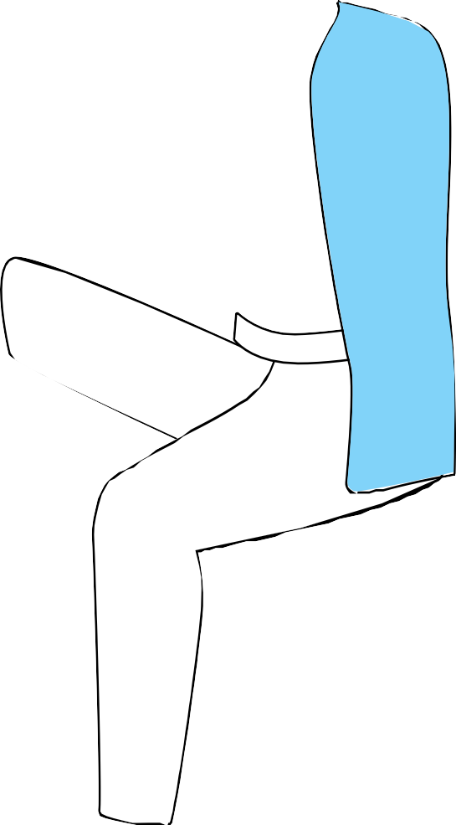













Example background scene - outlined charcters on an outlined background

Slide 8




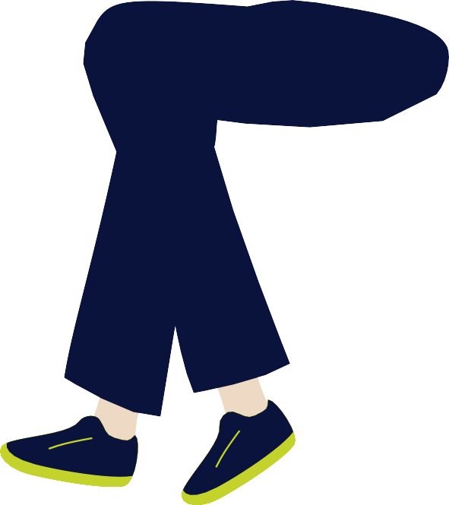







Example background scene - solid ﬁll charcters on an outlined background

Slide 9

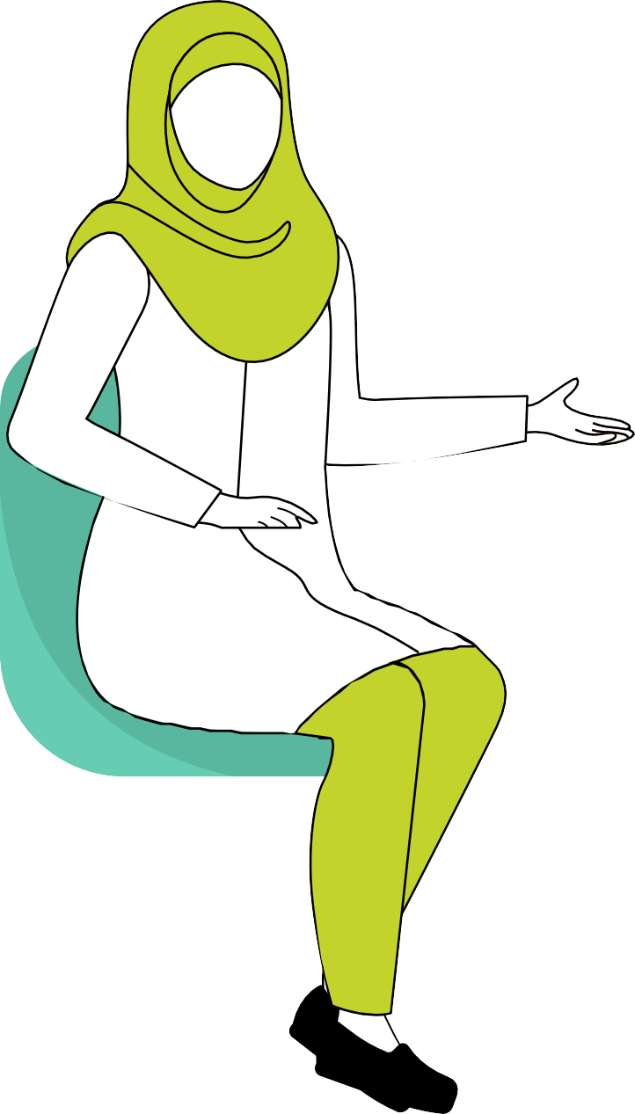















Example background scene - outlined charcters on a solid ﬁll background

Slide 10


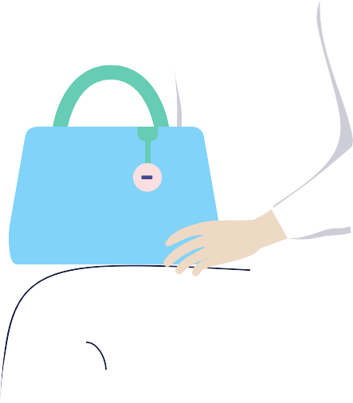

Example background scene - solid ﬁll characters on a solid ﬁll background

Slide 11










Example background scene

Slide 12



Example background scene

Slide 13


Example background scene

Slide 14
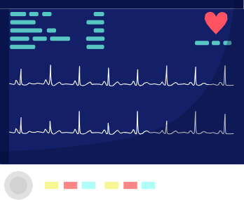
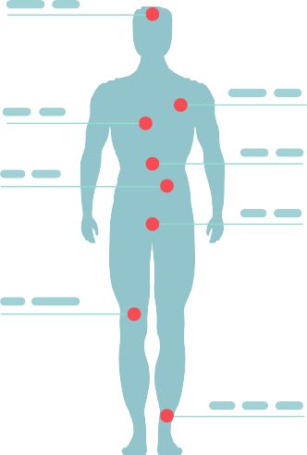












Example background scene

Slide 15


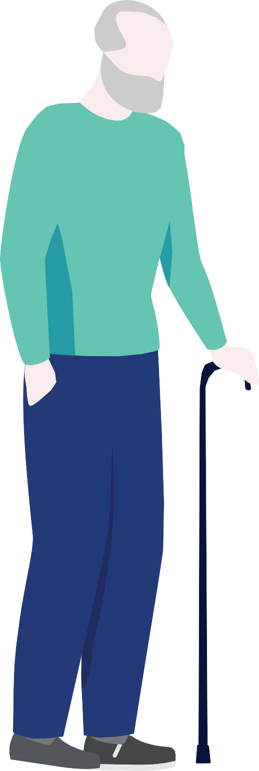


Example background scene

Slide 16

Deloitte refers to one or more of Deloitte Touche Tohmatsu Limited
(collectively, the “Deloitte organization”). DTTL (also referred to as “Deloitte separate and independent entities, which cannot obligate or bind each related entity is liable only for its own acts and omissions, and not those
of each other. DTTL does not provide services to clients. Please see www. deloitte.com/about to learn more.
© 2021. For information, contact Deloitte Touche Tohmatsu Limited.

